Slide 1
BANKING MANAGEMENT SYSTEM WITH TRANSACTION LOGS
Developed By: C Sri Harsha
Technology: Java, MySQL
Date: 1/11/2025

Slide 2
Project Abstract :
A comprehensive banking application that manages customer accounts, performs financial transactions, and maintains detailed transaction logs with robust exception handling.
Account Management (Create, View, Close) - Financial Transactions (Deposit, Withdrawal, Transfer) - Real-time Balance Updates - Complete Transaction History - Audit Trail with Transaction Logs - Custom Exception Handling - Multi-tier Architecture

Slide 3
Tech Stack:
Programming Language: Java 17
Database: MySQL 8.0+
Build Tool: Maven 3.6+
Logging: SLF4J + Logback
Database Driver: MySQL Connector/J 8.0.33
Testing: JUnit 5, Mockito
IDE: IntelliJ IDEA
Architecture: Layered (Presentation → Service → DAO → DB)

Slide 4
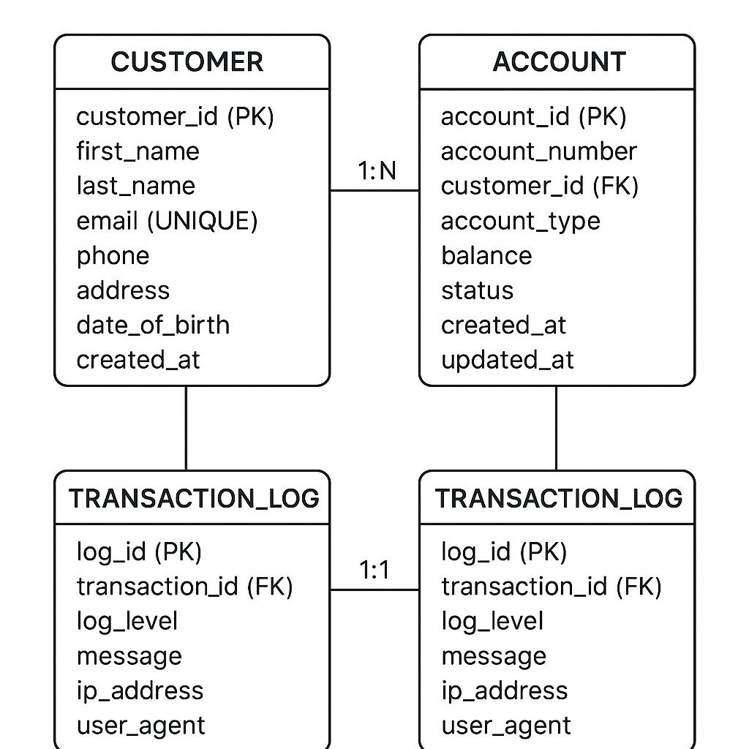
ER Diagram

Slide 5
Key Features:
1. Account Management – Create, View, Close
2. Transactions – Deposit, Withdraw, Transfer
3. Transaction Logging – Database & File Logs
4. Exception Handling – Custom Error Classes
5. Real-time Balance Updates

Slide 6
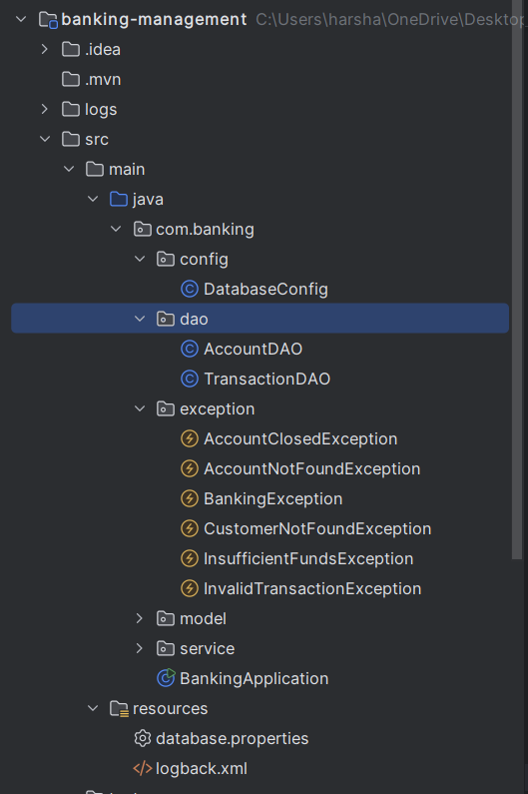
Project Structure:

Slide 7
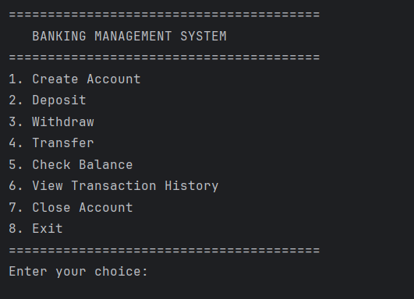
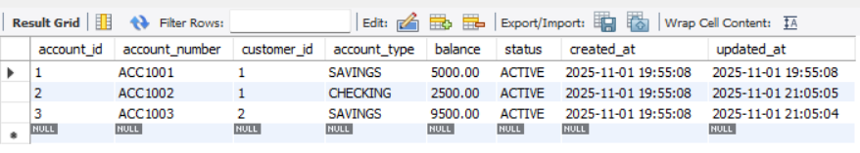
Output Screenshots:

Slide 8
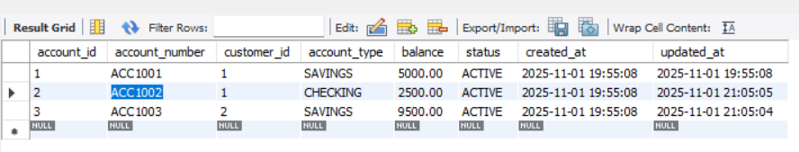
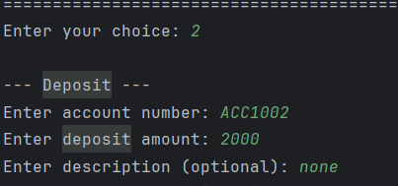
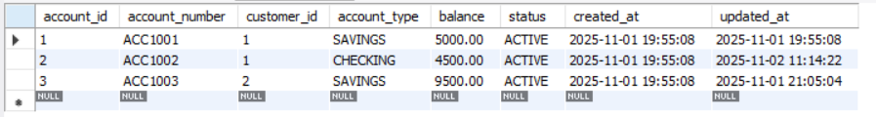
Deposit:

